Slide 1

INFLUENCES ON AUSTRALIAN POLITICAL SYSTEM

Slide 2
SYLLABUS DOT POINT (examinable material)
Key influences on the structure of the political and legal system in Australia

Slide 3
RECAP
What is Terra Nullius?
What was early colonial government?
Why did people want self-government?
Name and explain one feature Australia’s Parliament took from the Westminster system?
What did Australia take from Westminster judicial system?
What is the difference between Federation and Federalism?

Slide 4
AUSTRALIA’S INFLUENCES?
WESTMINSTER INFLUENCE
WASHINGTON INFLUENCE
CANADIAN FEDERAL INFLUENCE
SWISS REFERENDUM PROCESS

Slide 5
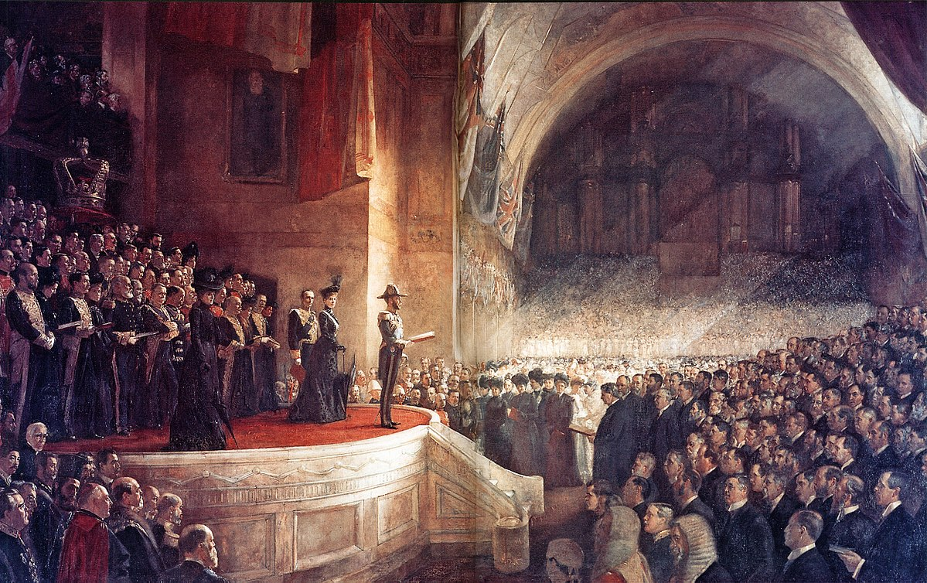
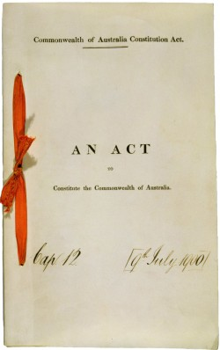
How Australia formed its Constitution

Slide 6
What is a Constitution?
A constitution is a set of rules by which a country or state is run.
Some countries have unwritten constitutions which means there is no formal constitution written in one particular document. Their constitutional rules are derived from a number of sources. Britain (constitutional monarchy) sources its constitution from a number of important statutes, or laws, as well as principles decided in legal cases and conventions (incl. NZ & Israel).
Other countries have formal written constitutions in which the structure of government is defined and the respective powers of the nation and the states are written in one single document. These systems may also include unwritten conventions and constitutional law which can inform how the constitution is interpreted. Australia, India and the United States are examples of countries with a written constitution.
Special procedure must be followed before a constitution can be changed. Australia has a constitution which requires a referendum in order to change it.

Slide 7
Federation
The Commonwealth of Australia was formed on 1 January 1901 when six partly self governing British colonies united to become sates of a nation
The rules of government for this new nation were enshrined in the Australian Constitution, which defined how the Commonwealth government was to operate and what issues it could pass laws on
The main purpose of the Constitution was to create a federal compact = an agreed division of powers between the new Commonwealth Parliament and the State Parliaments
The birth of our nation is often referred to as ‘federation’ because the Constitution created a ‘federal’ system of government.
Under a federal system, powers are divided between a central government and individual states
Notes:
The Constitution is relatively short document made up of 128 sections, divided into 8 chapters
Chapter 1 to 3, which makes up over half of the document, sets out the legislative, executive and judicial institutions of the Commonwealth government and divides legislative powers between the Commonwealth and the states
Willmott pages 103 - 106

Slide 8
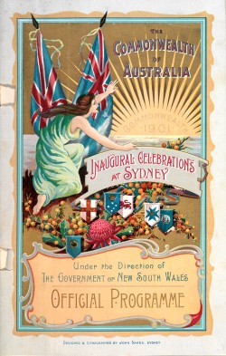
The Australian Constitution
Contains eight (8) chapters / 128 sections
Chapter 1 – 3: Allocates/separates legislative, executive and judicial power
The Constitution does the following:
It outlines the functions and structure of Parliament
It establishes the powers of Parliament
It provides for the settling of disputes about the Constitution
It outlines the procedures for changing the Constitution

Slide 9
Key external influences
The writers of the AUS Constitution accepted that British Westminster traditions would form the basis of processes and procedures of a united Australian government.
However, the federal systems of the US and Canada provided a model by which Australia could achieve unity, while allowing the colonies to retain their separate identities and maintain a significant degree of self-government
The key external influences on the structure of Australia's political and legal system include:
The Westminster system of government
English common law
The American Federal system
The Canadian Federal system
The Swiss Referendum process
Notes:
Willmott page 88-90

Slide 10
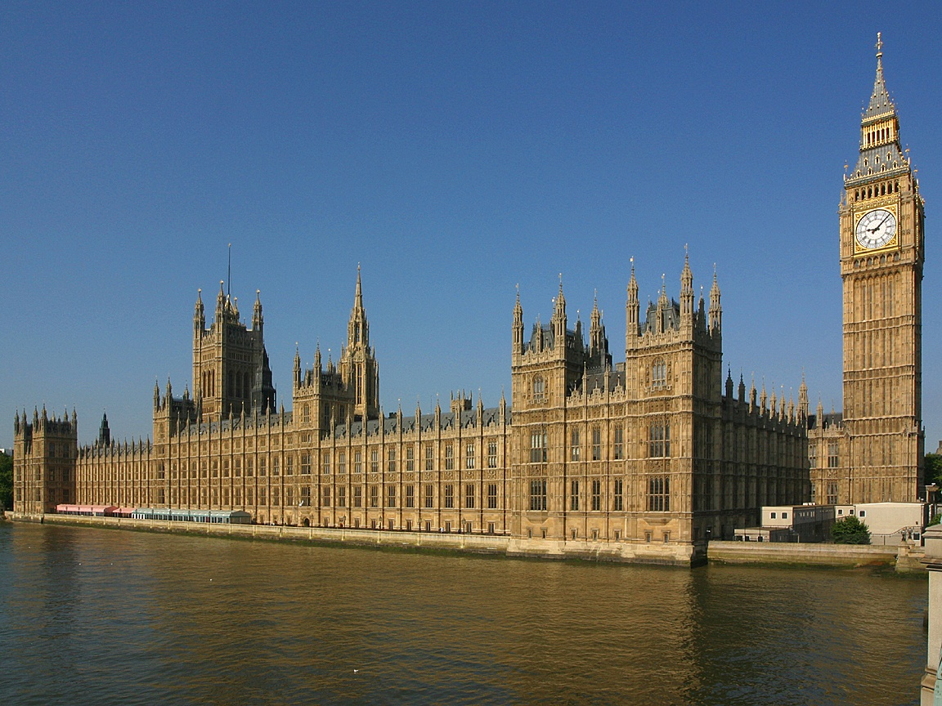
Overview
When the colonies had achieved self-government, they set up political institutions based on the British Westminster system
When debates regarding unity occurred (1890’s), the focus was primarily on the Westminster system
The constitutional writers assumed the model of Britain – responsible government
Consequently, little attention was given to the processes and procedures of government in 1901

Slide 11

WESTMINSTER INFLUENCE
The British and US systems of government have had substantial influence on the Australian system of government. In fact the Australian federal Parliament has been referred to as a "Wash-minster" model – a combination of the US "Washington" model and the British "Westminster" model.
Before 1901, the self-governing colonies were modelled on the British Parliamentary system; when developing the Australian federation model in the 1890s, the British Parliamentary model was very influential.
This influence can be seen in many aspects of the appearance and function of the two chambers of the Australian Parliament.
Australia took the concept of responsible government from the Westminster system
Responsible government = To remain in government, a party or coalition must maintain the support of the majority of members in the House of Representatives. This ensures that the government is accountable to the Parliament.

Slide 12
RESPONSIBLE GOVERNMENT
The principles of a responsible government are:
Ministers are responsible to parliament and therefore to the people – a minister can be called to explain in parliament his or her actions and those of the department and agencies under his or her control = ministerial accountability
Example: Michaela Cash and her leaking adviser illustrates a failure of ministerial responsibility. Her office’s role in tipping off media to police raids on union offices
Members of parliament have the opportunity to question ministers about their activities and the activities of their department (Question Time)
Minister must carry out their duties with integrity and propriety or resign
There are opportunities for public scrutiny of the law-making process so the public can hold the government accountable or its actions; the government must respond to concerns/answer questions where appropriate
A record of parliamentary proceedings is kept in Hansard which is available to the public, and the public can view parliament in operation
If the government loses the support of the lower house it must resign (no confidence motion)

Slide 13

Britain
However, these are mostly left to constitutional conventions rather than being specified in the Constitution itself.
The main Westminster conventions are:
Head of State = British monarch
Head of Government = PM
The GG acts on the advice of the PM
The Prime Minister is a member of the lower house, and Ministers must be members of parliament
The PM and Ministry must have majority support in the lower house
Ministers are collectively and individually responsible to the parliament
An independent judiciary

Slide 14
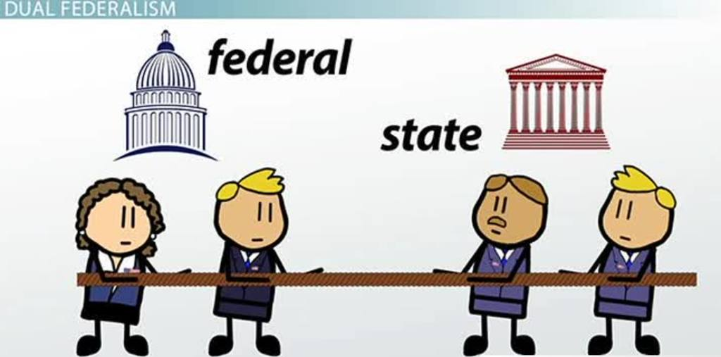
Issues with BRITAIN
The Constitution provides few specific rights for Australian citizens. These are assumed to be protected by the operation of the British system of common law that already existed in Australia
Britain had a unitary government, a single government that legislated in England, Scotland, Wales and Ireland (Acts of Union, 1707)
However, Australian colonies did not want the one central government who had total dominance
They wanted unity but also to preserve their own identities
What model would have appealed to them?
FEDERALISM!
The US, Canada and Switzerland had these systems at the time….

Slide 15

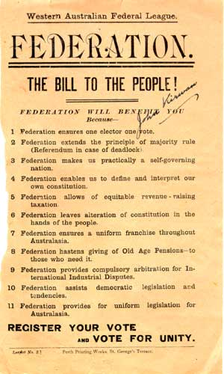
AMERICAN INFLUENCE
In 1890s, Australians were most impressed by the US system
The major influence of the US system can be seen in the overall model of Australian federation
Independently governed states working together under a central federal government structure.

Slide 16
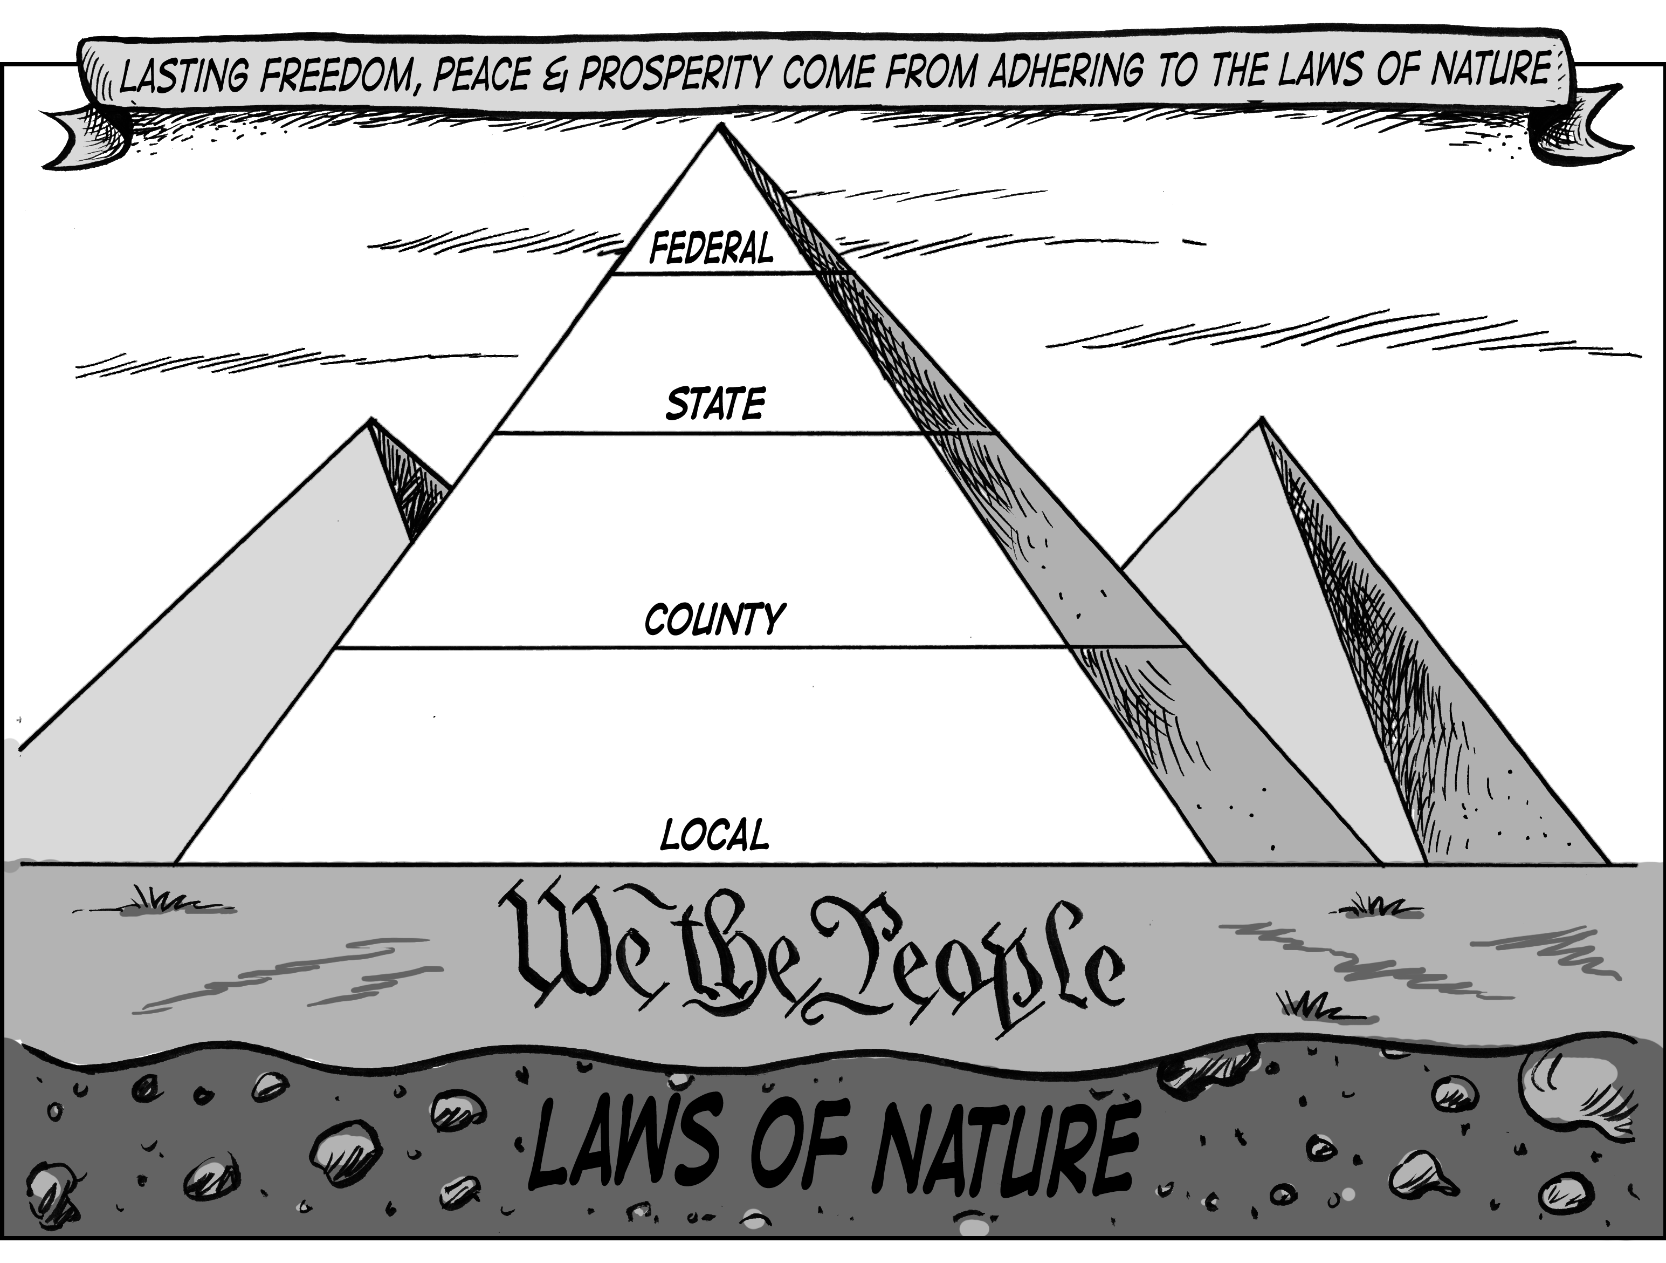
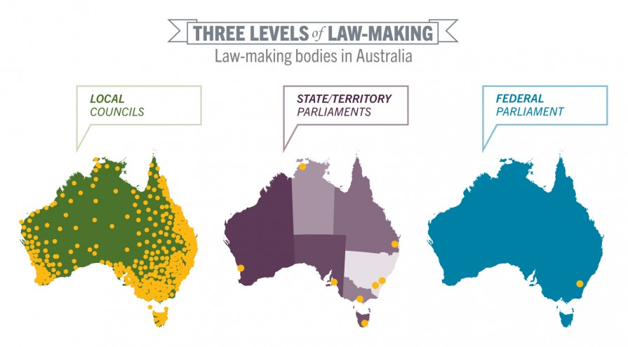
SAME LEVELS…FEDERALISM

Slide 17
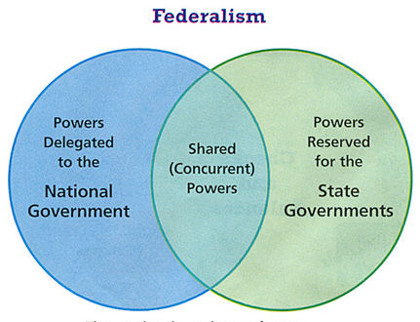

Slide 18

Division of Powers
The Constitution sets out clearly the division of powers between the State and Federal Governments. It does this by stating the powers given to the Federal Government and then providing that the powers not mentioned remain with the states = residual powers
The Constitution allows the states to make laws in areas over which the Commonwealth has power (provided that the state laws do not conflict with those of the Commonwealth). This occurs where the states and the Commonwealth have concurrent powers – that is, a shared power to legislate. E.g. Taxation
Note: If there is a conflict of interest between the states and the Federal Government, or if there is an inconsistency in these laws, the federal laws prevail over state law (s. 109)

Slide 19
Division of Powers
The original spirit of the Constitution is generally considered to restrict Commonwealth power to areas of ‘national significance’.
The Constitution outlines specific powers given to the Commonwealth by the states.
Specific powers:
Exclusive: powers that can only be exercised by the Federal Parliament
Concurrent: powers that can be exercised by both the states and the Commonwealth
Residual powers
Before Federation, each colony had its own set of powers. At Federation some of those powers were handed over to the Commonwealth (s. 51). The remaining powers stayed with the states (s. 108); they are called the residual powers and only the states can makes laws based on these powers

Slide 20
Specific Powers
Note: S. 51 lists 40 areas over which the federal Parliament has legislative power. Most specific powers are contained in this section (39 paragraphs)
Exclusive:
S. 90: the power to impose customs and excise duties
S. 114: prohibits the states from raising naval or military forces
S. 115: prohibits the states from minting their own coins
Concurrent:
S. 51
Trade and commerce with other countries
Taxation
Postal, telegraphic and similar services
Marriage
divorce

Slide 21
Specific Powers
Under s. 51, state parliaments can refer matters to the federal Parliament. That is, they can ask the federal Parliament to make laws about an issue that is otherwise a state responsibility
S. 52 stops state parliaments from making laws in some areas, incl. defense and communication

Slide 22
Residual Powers
Examples of residual powers can be found in the areas of:
Law and order (police; prisons)
Commerce and industry
Education
Housing
Transport
Development (roads; railways; utilities – electricity; water supply)
Public health (hospitals; ambulance services) and social welfare issues

Slide 23
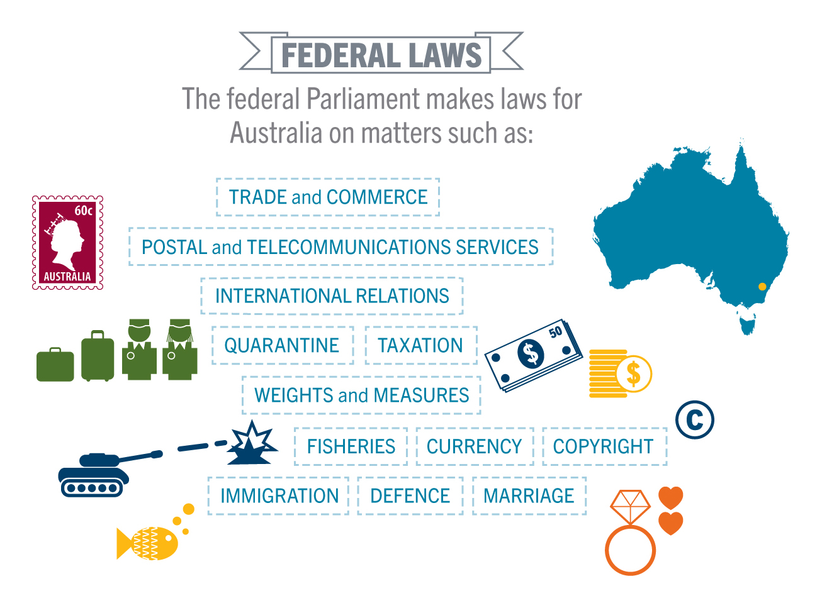

Slide 24
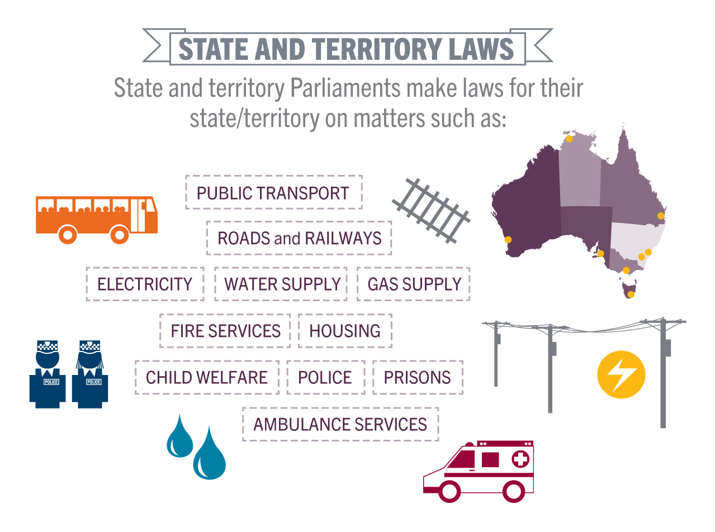

Slide 25
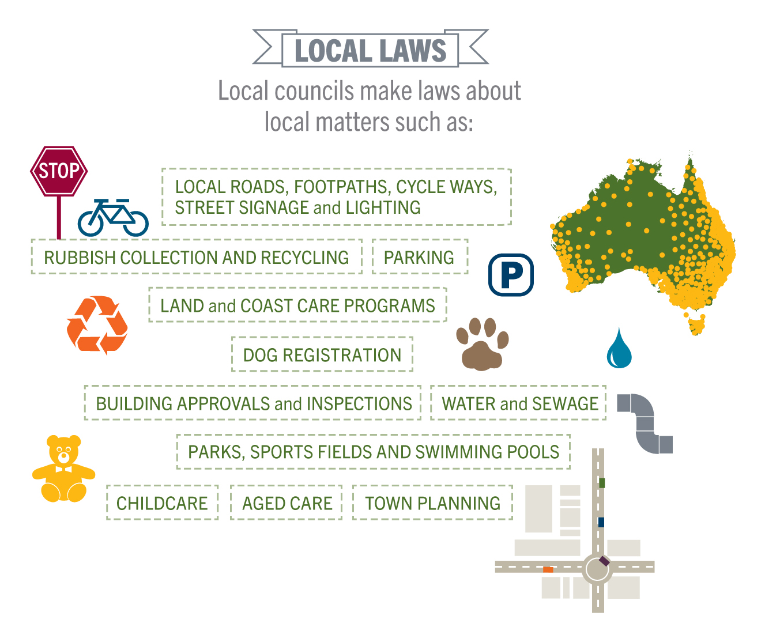

Slide 26

AMERICAN INFLUENCE
Also, the representative structure of the Australian Senate draws heavily on the US model of the Senate (State’s house).
Judiciary – The High Court is based on the US Supreme Court – role to interpret the Constitution
The American tradition is expressed through a written constitution defining the powers of the national government (Britain = unwritten constitution)

Slide 27
SUMMARY OF AMERICAN INFLUENCES…
Federalism/Division of Powers between central and State governments
The Senate (State’s house)
The High Court
Written Constitution to outline powers of Parliament

Slide 28
THIS LESSON….
WESTMINSTER INFLUENCE
AMERICAN FEDERAL INFLUENCE
CANADIAN FEDERAL INFLUENCE
SWISS REFERENDUM PROCESS

Slide 29

CANADIAN FEDERAL INFLUENCE
The Canadian Constitution was intended to establish a strong central government
The Canadian Constitution of 1867:
The central and regional governments given specified powers but extensive areas of residual powers were given to central government – How is this different to Aus?
A Canadian Senate was created that composed of ‘leading citizens’ appointed by the central government – How is this different?
Central government was given unlimited taxation powers and power to disallow any regional legislation – How is this different?
These aspects of Canadian federalism only had limited appeal for the writers of the Australian Constitution

Slide 30
CANADIAN INFLUENCE
The Canadian Constitution was the first to create a ‘Washminster’ system – it combined American federalism with Westminster model of responsible parliamentary government
What is a responsible parliamentary government?
It is a system of government taken from the British Westminster principles – the executive must be supported by a majority of the parliament that is itself responsible to the people. If a no-confidence motion is passed in the lower house, or they are defeated at an election – they must resign
The Canadian legislature (House of Commons after Westminster) selects the executive arm from its own members
These members of Parliament remain in power while they have majority support in the lower house
How is this system the same as Australia?
Australian Constitutional writers liked the way Canada had a Westminster system with federalism imposed on it – ‘Washminster’

Slide 31
Canadian influence
As well as the concept of responsible government, Australia also took section 51 of the Constitution from the Canadians
Section 51 (“The Parliament shall, subject to this Constitution, have power to make laws for the peace, order, and good government of the Commonwealth with respect to(specified powers)” = same as Section 91 of Canadian Constitution (“It shall be lawful for the Queen, by and with the Advice and Consent of the Senate and House of Commons, to make Laws for the Peace, Order, and good Government of Canada”)

Slide 32

SWISS INFLUENCE - REFERENDUM
Swiss Constitution has a long historical tradition of autonomous local government and direct democracy
In Switzerland, the Constitution can only be changed through a referendum that is approved by a majority of citizens and a majority of states – double majority
A double majority means that a majority of States (4/6) and a majority of citizens must say Yes for a referendum to be successful
The Australian Constitutional writers liked the Swiss approach and the safeguards for the protection of the federal system – changes could be made but not in haste – why?
It encourages public discussion and delay change until it is desirable, irresistible and inevitable

Slide 33
SUMMARY
Write down the influences that helped to develop the Australian system of Government …
…ensure you explain at least one influence from Westminster, US, Canada and Switzerland

